Slide 1
Mining of Massive Datasets
Advanced Big Data Analysis (GR24254-1)
2.5 The Communication-Cost Model
Ngumimi Karen Iyortsuun
30th September 2024

Slide 2
Content
Communication-Cost Model Overview
Communication Cost in Task Networks
Wall-Clock Time
Multiway Joins (and Their Efficiency)
Star Joins

Slide 3
2.5 Communication-Cost Model Overview
Measurement of the quality and efficiency of algorithms based on how much data needs to be moved (communication) between different parts of the computing clusters
Goal- to understand how the cost of data transfer affects the overall computation time and performance
Represented as an acyclic workflow (there are no cycles or loops in the tasks) to help organize tasks in a clear, step-by-step manner
Acyclic network: Each task output is an input for another task (no returning to the previous task)
We will look at how data is transferred between tasks, especially in processes like Multiway joins in MapReduce

Slide 4
2.5.1 Communication Cost for Task Networks
The communication cost of a task
is the size of the input to that task, which can be measured in bytes or, particularly for relational databases, in the number of tuples (records).
The total communication cost for an algorithm
is the sum of the communication costs of all individual tasks within the algorithm.
The execution time of each task is not considered in this model because, in many cases, communication costs overshadow the execution times.
Simplicity of Tasks:
The algorithms executed by each task are often simple (linear) and process data quickly once it’s received.
Interconnect Speed:
The typical communication speed in computing clusters is around one gigabit per second (fast, but relatively slow compared to processor execution speed).
When multiple nodes in a cluster communicate simultaneously, competition for bandwidth can slow down communication, meaning that a node can perform a significant amount of work on incoming data while waiting for the data to arrive.
Data Retrieval from Disk:
Even if a task is executed on a node that has the required data chunk, that data often resides on disk and needs to be loaded into memory.
The time to transfer data from disk to memory can exceed the time it takes to process that data once it’s available, reinforcing the importance of minimizing data movement.

Slide 5
2.5.1 Communication Cost for Task Networks
Assuming that communication cost is the dominant cost, Why Only Count Input Size?
Output Size Accounting:
If the output of one task becomes the input for another, the output size is implicitly accounted for in the input size of the receiving task.
No need to count the output size separately, except for the final output of the entire algorithm.
Output Size Relative to Input:
The final output of an algorithm is often much smaller than the total input or intermediate data generated during processing.
Large outputs generally need to be summarized or aggregated.
E.g., instead of calculating an exhaustive transitive closure of a graph, which might produce extensive output, one would typically only require simpler metrics, like the number of reachable nodes or the set of reachable nodes from a single source.
How many nodes can be reached from a single node?
Which specific nodes are reachable from a single starting point?

Slide 6
2.5.1 Communication Cost for Task Networks Example
Communication Cost Breakdown
Map Tasks:
Suppose we are joining R(A, B) ⊲⊳ S(B, C), and the sizes of relations 𝑅 and 𝑆 are r and s, respectively.
Each chunk of the relations 𝑅 and 𝑆 is processed by individual Map tasks. Thus, the total communication cost for the Map tasks is 𝑟 + 𝑠.
Map task transformations are straightforward, leading to a computation cost generally small compared to the communication cost.
Output from Map Tasks:
The total output size from the Map tasks is expected to be roughly equal to the size of their inputs (𝑟+𝑠).
Each key-value pair output by the Map tasks is sent to a specific Reduce task.
It’s unlikely that the Reduce task will execute on the same node as the Map tasks, leading to communication over the cluster's interconnect.
Communication Cost for Reduce Tasks:
The communication cost for transferring outputs from the Map tasks to the Reduce tasks is also 𝑂(𝑟+𝑠), emphasizing that the communication cost remains proportional to the input sizes.

Slide 7
2.5.1 Communication Cost for Task Networks Example –cont.
Reduce Tasks and Output Size
Reducer Functionality:
The Reduce tasks take the key-value pairs and apply the reducer function to combine values associated with the same key B.
Each tuple from R pairs with tuples from S based on the common attribute B to generate the final output.
Output Size Considerations:
The size of the output from the join operation can vary:
If there are many distinct values of B, the output is likely smaller since fewer tuples will match.
If there are few distinct values, the output can be significantly larger.
In cases of large output, the computation cost required to generate all outputs from the reducers could exceed O(r+s).
Aggregation and Communication Cost:
Even if the output is large, it is often expected that some form of aggregation will occur to reduce output size.
The result of the join operation may need to be communicated to other tasks for further processing or aggregation, reinforcing that the communication cost is likely proportional to the computation required to produce the output.

Slide 8
2.5.2 Wall-Clock Time
In the context of parallel algorithms, it is the time from when the first task starts until the last task finishes.
Wall clock time refers to the time it takes for an algorithm to run from start to finish in real-world terms.
Although minimizing communication costs is crucial, focusing solely on this metric can lead to inefficient algorithms when measured by wall-clock time.
For example, if all tasks and data processing are assigned to a single task, communication costs could be minimized, but this approach would result in a high wall-clock time because the task would take too long to finish the entire workload on its own.
The key to improving wall-clock time is to divide the work fairly among the available compute nodes.
By distributing the tasks evenly across the nodes, each task can be executed in parallel, reducing the overall time taken to complete the algorithm.
Takeaway:
The goal is not just to minimize communication, but to ensure that the total elapsed time (wall clock time) is as low as possible.

Slide 9
2.5.3 Multiway Joins (and Their Efficiency)
Multiway joins can be optimized by analyzing the communication cost in a cluster computing environment, particularly using a MapReduce framework.
A multiway join involves joining three or more relations (tables) – illustrated here as 𝑅(A, B), 𝑆(𝐵,𝐶), and 𝑇(𝐶,𝐷) to optimize MapReduce and communication cost analysis.
General Approach for Multiway Joins:
Hashing attributes:
Some attributes from the relations are selected and hashed into buckets (i.e., groups) to enable efficient joining. In this example, attributes 𝐵 and 𝐶 are selected.
Number of buckets:
Each attribute is hashed into a certain number of buckets, and the product of the number of buckets for each attribute must equal 𝑘, the number of reducers that will be used.
Reducers identified with vectors:
Each reducer is associated with a vector representing a combination of bucket numbers for each attribute.
Sending tuples to reducers:
Each tuple (row of data) from the relations is sent to all reducers where it might find matching tuples to join with.

Slide 10
2.5.3 Multiway Joins (and Their Efficiency)
Example: Joining Three Relations
Given R(A,B), 𝑆(𝐵,𝐶), and 𝑇(𝐶,𝐷)
Step-by-Step Two-Way Join:
First, we join 𝑅(A, B) and 𝑆(𝐵,𝐶), producing an intermediate result of size prs where p is the probability that an R-tuple and S-tuple agree on B.
Then, this intermediate result is joined with 𝑇(𝐶,𝐷), producing the final output.
The total communication cost for this approach is 𝑂(𝑟+𝑠+𝑡+𝑝𝑠𝑡).
If we change the order and first join 𝑆(𝐵,𝐶) with 𝑇(𝐶,𝐷), then the communication cost is 𝑂(𝑟+𝑠+𝑡+𝑝𝑠𝑡), where 𝑝 is now the probability that 𝑆-tuples and 𝑇-tuples agree on 𝐶.
Single MapReduce Job for Multiway Join:
In this approach, a single MapReduce job joins all three relations in one go. Here, k reducers are used, and we pick b and ccc to represent the number of buckets for the B-values and 𝐶-values, respectively.
Hash functions:
A hash function h(v) is used to assign B-values to b buckets, and another hash function g(w)g(w)g(w) assigns 𝐶 -values to ccc buckets. The total number of reducers 𝑘 is the product of the number of buckets, so 𝑏𝑐=𝑘.
Each reducer handles joining the tuples where h(v)=i and 𝑔(𝑤)=𝑗, which ensures that the right tuples from 𝑅, 𝑆, and 𝑇 are combined.

Slide 11
2.5.3 Multiway Joins (and Their Efficiency)
Example: Joining Three Relations
Handling the Distribution of Tuples to Reducers
For 𝑆(𝐵,𝐶):
Since an S-tuple contains both B- and C-values, it is easy to determine which reducer it should be sent to based on the hash functions h(v) and g(w).
For 𝑅(A,B):
The RRR-tuple only contains the B-value, so it needs to be sent to multiple reducers since we don’t know the C-value. Specifically, it must be sent to all reducers that handle the possible C-values (there are c such reducers, one for each possible bucket for C).
For 𝑇(𝐶,𝐷):
Similarly, a T-tuple contains only the C-value, so it must be sent to all reducers responsible for the different B-values (there are b such reducers, one for each bucket for B).

Slide 12
2.5.3 Multiway Joins (and Their Efficiency)
Example: Joining Three Relations - Trade-Offs and Efficiency
By using this strategy, we avoid performing multiple sequential MapReduce jobs, which would increase communication costs.
Instead, the tuples are distributed more intelligently using the hashing mechanism, potentially reducing overall communication costs in a single MapReduce job.
However, since some tuples are sent to multiple reducers, this approach involves duplicate communication for tuples of 𝑅 and 𝑇, as they are sent to more than one reducer to ensure all possible matches are considered.
This is often still more efficient than performing multiple two-way joins in separate steps.

Slide 13
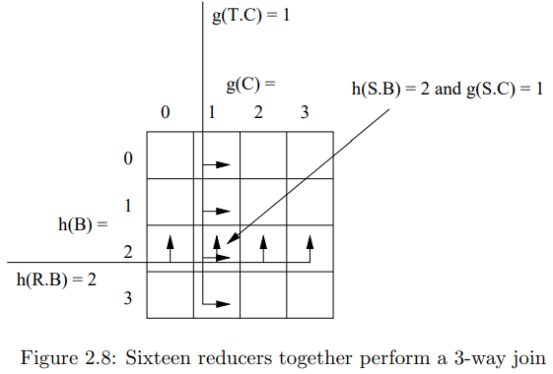
2.5.3 Multiway Joins (and Their Efficiency) Example 2.15:
This example illustrates how multiway joins (joining multiple relations) can be optimized by hashing the key attributes and distributing them among reducers in a MapReduce framework.
The goal is to minimize the communication cost when moving data between tasks.
Setting:
We are performing a join on three relations: R(A, B), S(B, C), and T(C, D).
We assume:
Relation R has size r,
Relation S has size s,
Relation T has size t.
The goal is to distribute the work among k reducers (in this case, b=4 buckets for B-values and c=4c buckets for C-values, so k = b × c = 16).
Process:
Hashing the tuples:
The three tuples 𝑆(𝑣,𝑤), 𝑅(𝑢,𝑣), and 𝑇(𝑤,𝑥) all meet at exactly one reducer — the one responsible for key (2,1), where they can be joined.

Slide 14
2.5.3 Multiway Joins (and Their Efficiency) Example 2.15:
This example illustrates how multiway joins (joining multiple relations) can be optimized by hashing the key attributes and distributing them among reducers in a MapReduce framework.
The goal is to minimize the communication cost when moving data between tasks.
Communication Cost:
To minimize the cost of moving data between tasks, we need to compute the total communication cost for distributing the tuples from the three relations to the reducers:
Cost for relation S:
Each S-tuple is sent to exactly one reducer based on both the B- and C-values, so the communication cost is s.
Cost for relation R:
Each RRR-tuple is sent to ccc reducers (because the C-value is unknown, and there are c possible values for C). Thus, the communication cost is cr.
Cost for relation T:
Similarly, each T-tuple is sent to b reducers (because the B-value is unknown, and there are b possible values for B). Thus, the communication cost is bt.
In addition, there is a fixed cost of r + s + t for sending each tuple to a Map task, which does not depend on the values of b and c.

Slide 15
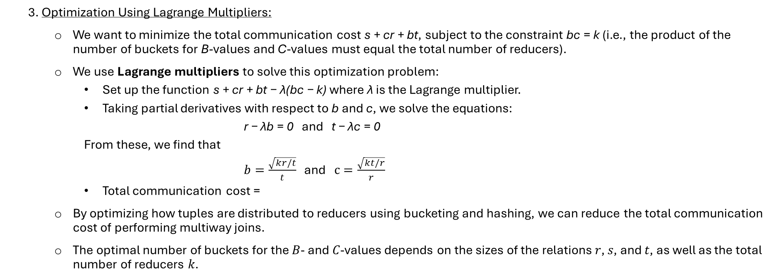
2.5.3 Multiway Joins (and Their Efficiency) Example 2.15:
This example illustrates how multiway joins (joining multiple relations) can be optimized by hashing the key attributes and distributing them among reducers in a MapReduce framework.
The goal is to minimize the communication cost when moving data between tasks.
3. Optimization Using Lagrange Multipliers:
We want to minimize the total communication cost s + cr + bt, subject to the constraint bc = k (i.e., the product of the number of buckets for B-values and C-values must equal the total number of reducers).
We use Lagrange multipliers to solve this optimization problem:
Set up the function s + cr + bt − λ(bc − k) where λ is the Lagrange multiplier.
Taking partial derivatives with respect to b and c, we solve the equations:
r − λb = 0 and t − λc = 0
From these, we find that
$b=\frac{\sqrt{kr/t}}{t}$ and $c=\frac{\sqrt{kt/r}}{r}$
Total communication cost =
By optimizing how tuples are distributed to reducers using bucketing and hashing, we can reduce the total communication cost of performing multiway joins.
The optimal number of buckets for the 𝐵- and 𝐶-values depends on the sizes of the relations 𝑟, 𝑠, and 𝑡, as well as the total number of reducers 𝑘.

Slide 16
Star Joins
A star join is a common structure in data mining, particularly in the context of commercial data, where it facilitates efficient querying and analysis.
Star joins optimize the performance of analytical queries in data warehousing by leveraging the structure of fact and dimension tables.
By utilizing multiway joins and effective data distribution strategies, star joins can significantly reduce communication costs, leading to faster query execution and more efficient data analysis.
This structure is particularly valuable when dealing with large datasets, where minimizing the movement of data can greatly enhance performance.

Slide 17
Thank you for Listening.

